Slide 1
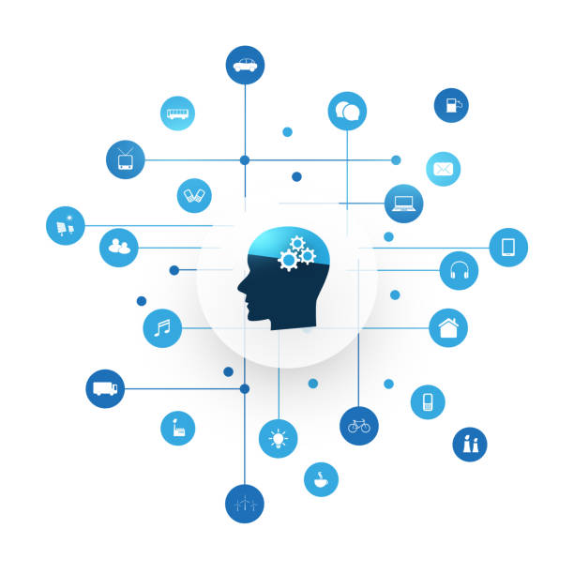
Introduction to Machine Learning for Beginners
Notes:
1

Slide 2
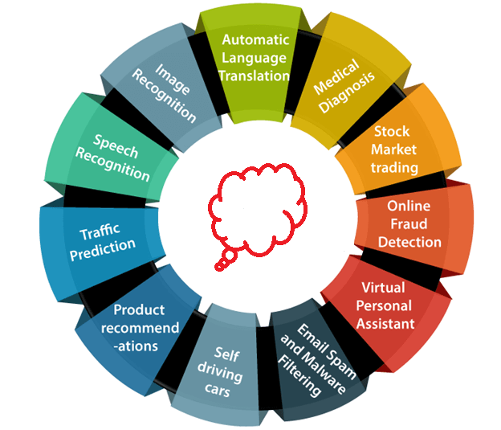
Some Applications
Notes:
2

Slide 3
Why Now?
Powerful machines that can handle computations quickly
Availability of huge amount of data
Advancement of technology and knowledge among people
Notes:
3

Slide 4
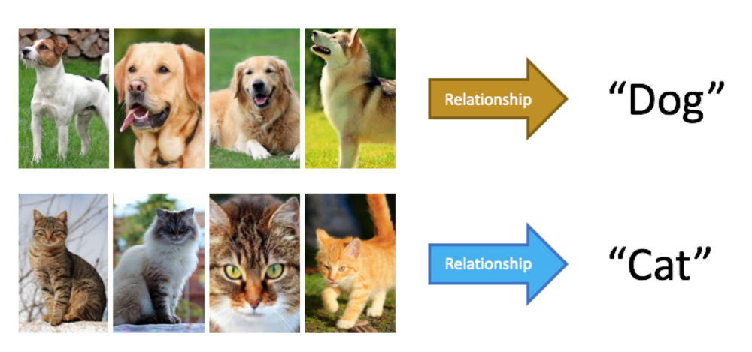
Learning From Data
Notes:
4

Slide 5
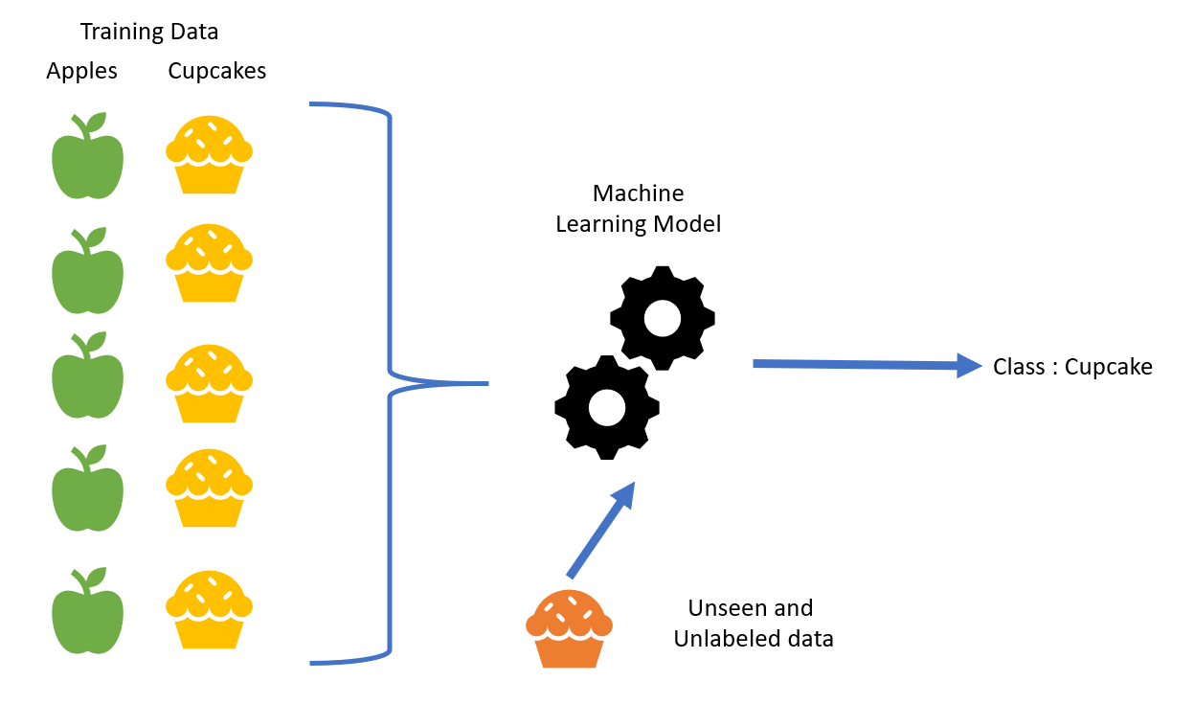
Supervised Learning
Notes:
5

Slide 6
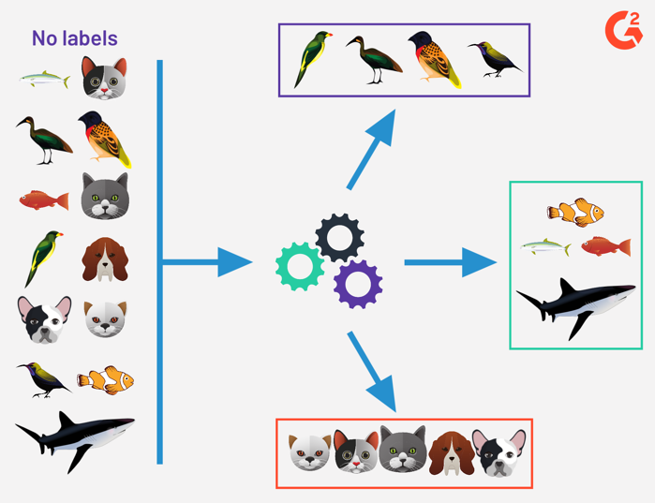
Unsupervised Learning
Notes:
6

Slide 7
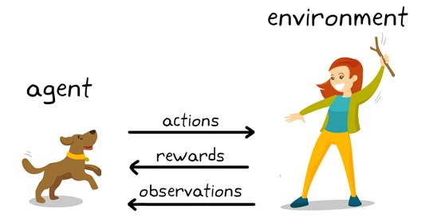
Reinforcement Learning
Notes:
7

Slide 8
Data Encoding and Preprocessing
Images
Videos
Audio
Text
One Hot encoding
Data standardization
Notes:
8

Slide 9
Model
Model is a function in the feature space
Notes:
9

Slide 10
Model
Model is a function in the feature space
Dimensions
Parameters
Hyperparameters
Notes:
10

Slide 11
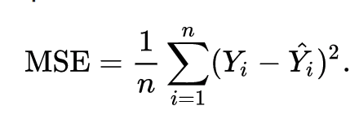
Error/Cost and Optimization
Notes:
11

Slide 12
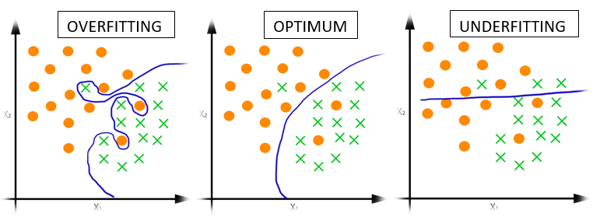
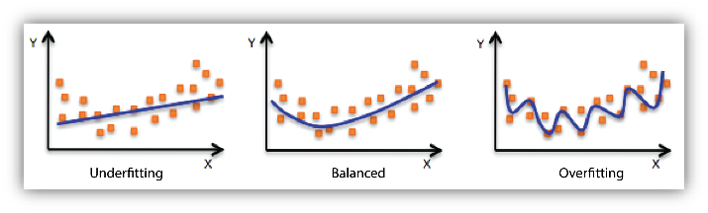
Overfitting
Notes:
12

Slide 13
Generalization and Validation Set
Notes:
13

Slide 14
Data Snooping and the Test set
Notes:
14

Slide 15
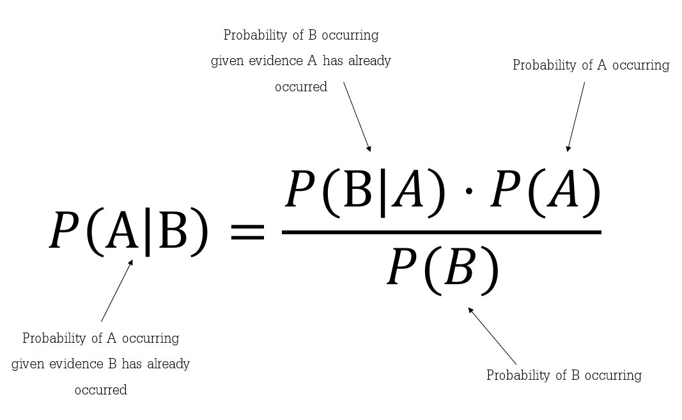
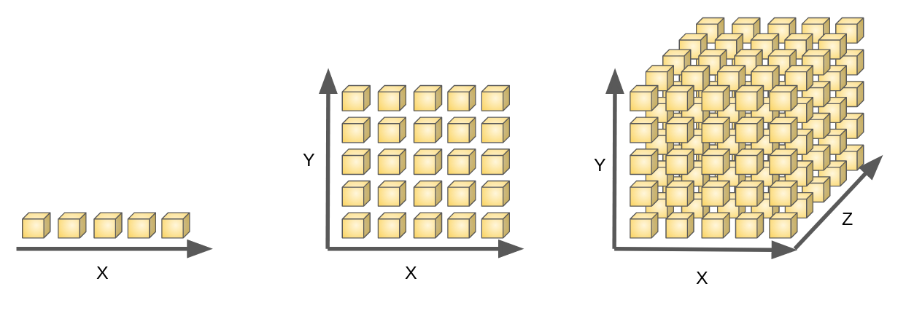
Probability Distributions and
Curse of Dimensionality
Notes:
15

Slide 16
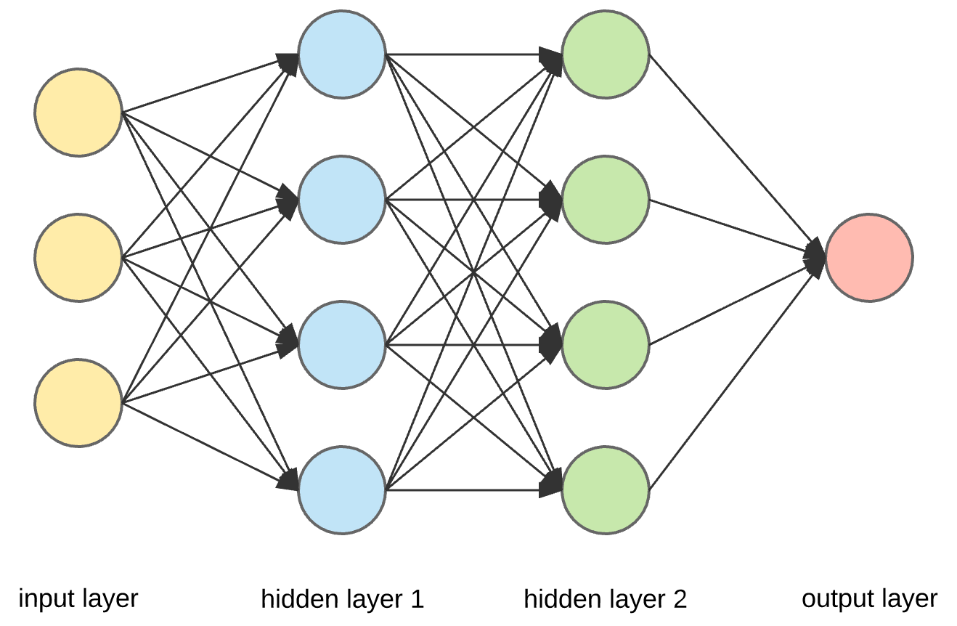
Deep Learning
Notes:
16

Slide 17
Machine Learning Pipeline
Data collection
Data preprocessing
Model Selection
Model Training
Model Evaluation
Incremental Training
Notes:
17

Slide 18
Face Recognition Example
Notes:
18

